Slide 1
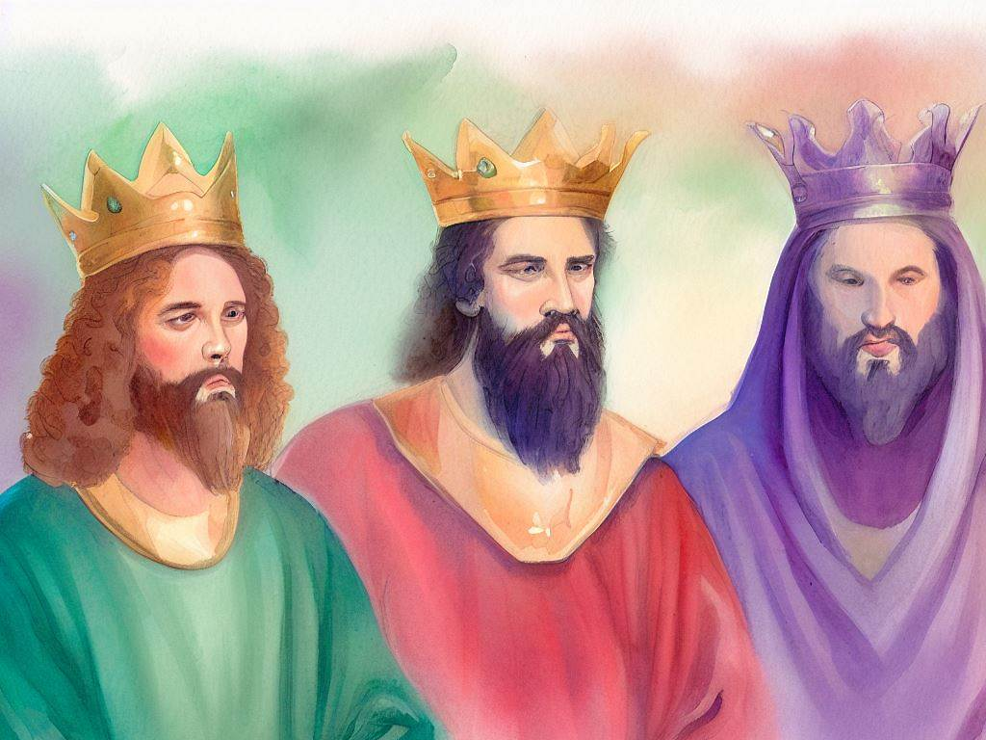
United Kingdom
Quarter 4: Lesson 9 Saul hunts David (1 Samuel 23:15-24)

Slide 2
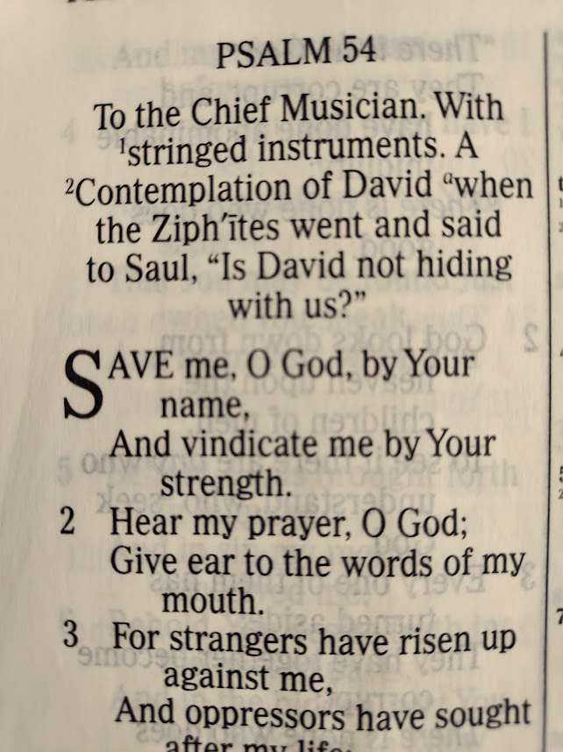
Saul Hunts David
David in the Wilderness (1 Sam. 23:15-29)
David spares Saul (1 Sam. 24)
Psalms 54 & 57

Slide 3
David in the Wilderness (1 Samuel 23:15-29)
Jonathan visits David in the Wilderness (25:15-18).
David is hiding in the wilderness of Ziph.
Jonathan visits David and “strengthens his hand in God.”
He assures David that “You shall be King in Israel…”
David and Jonathan make yet another covenant, and Jonathan returns home.

Slide 4
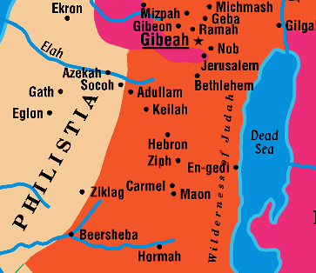
Geography of 1 Samuel 23 & 24

Slide 5
David in the Wilderness (1 Samuel 23:15-29)
The Men of Ziph betray David (23:19-29).
The Ziphites go to Saul in Gibeah and report that David is hiding in strongholds of Horesh, on the hill of Hakilah, south of Jeshimon*. They offer to deliver David into Saul’s hand (22:19-20).
Saul declares the Ziphites “blessed by the Lord” for helping him; he instructs them to surveil David’s location and movements for him (23:21-24).
When Saul comes after David, he is in the wilderness of Maon by the “rock.” Saul’s forces begin to encircle David (23:25-26).
Saul gets word that the Philistines are attacking Israel. He cuts off pursuit of David (23:27-28).
David escapes and dwells in En Gedi* (23:29).
Notes:
*Jeshimon is a word meaning wilderness or dessert.
The rock = Sela Hammahlekoth (Rock of Parting or Escape)
* Engedi means “fountain of the goats” or “spring of the kid”

Slide 6
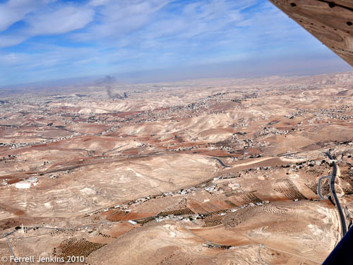
Wilderness of Maon Aerial view

Slide 7
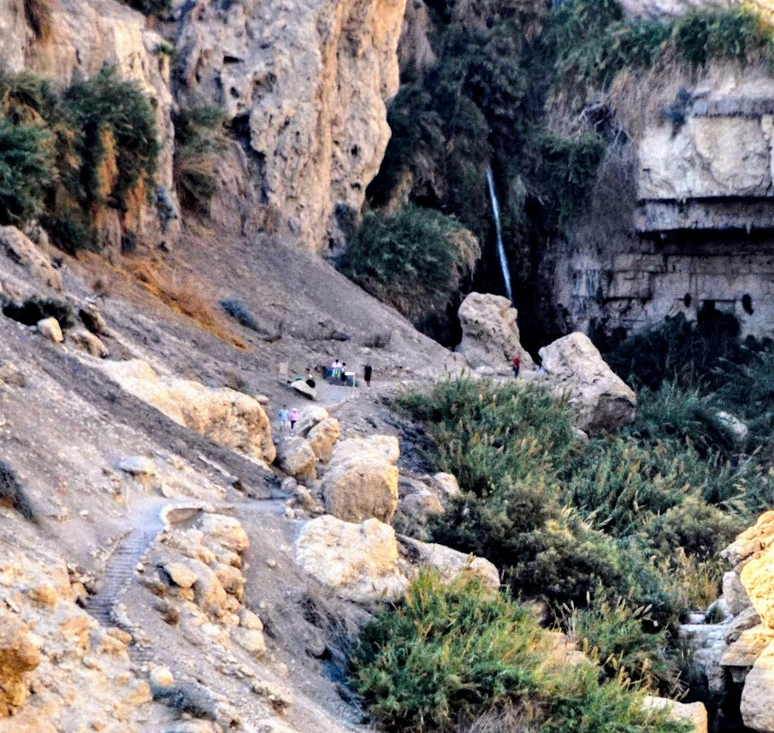
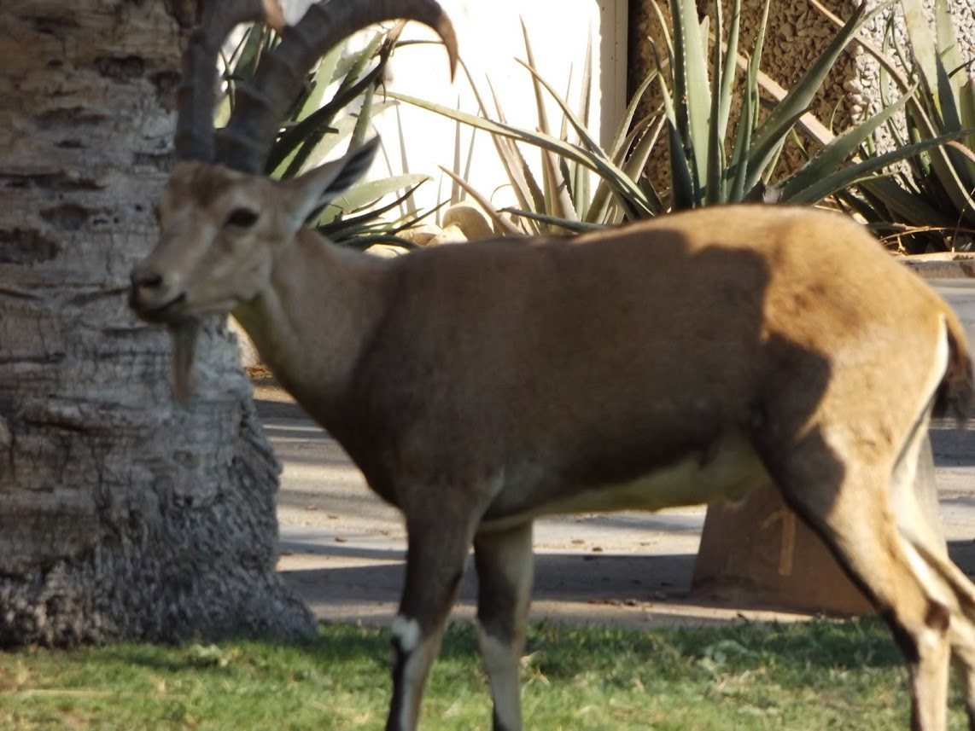
En Gedi
Notes:
Engedi
Ibex inset picture

Slide 8
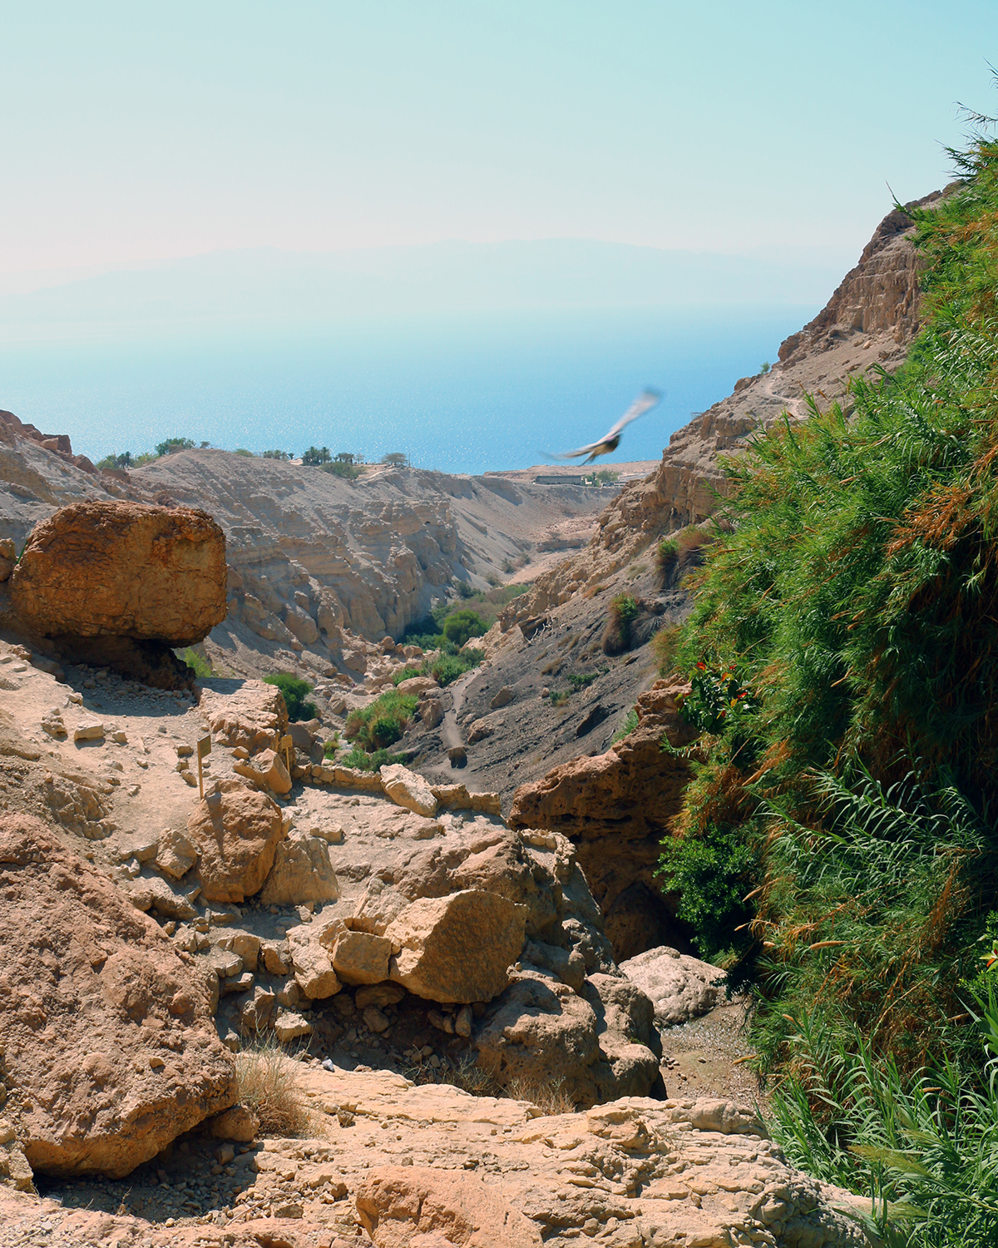
Notes:
View from the top of Ein Gedi looking back toward the Dead Sea. Trent & Rebekah

Slide 9
David Spares Saul (1 Samuel 24)
David spares Saul’s life (24:1-7)
Saul learns that David is in En Gedi and takes 3,000 select soldiers to hunt him on the rocks of the wild Goats (24:1-2).
He stops at a cave and enters it to attend to his needs, but David and his men are hiding in the recesses of the cave (24:3).
David’s men urge him to kill Saul. Instead, David cuts off the corner of Saul’s robe (24:4).
He feels guilty even for doing this, “The Lord forbid that I should…stretch out my hand against him, seeing he is the anointed of the LORD” (24:5-6).
David restrains his men from harming Saul (24:7).
Notes:
.

Slide 10
David Spares Saul (1 Samuel 24)
David’s Dialogue with Saul (24:8-22)
After Saul leaves the cave, David calls out after him, “My Lord the, King…” (8:8-15).
David bows and asks why Saul listens to those who say, “David seeks your harm.”
He tells Saul that although some urged him to harm Saul, he refused to stretch out his hand “against the Lord’s anointed.”
David has the corner of Saul’s robe in his hand.
“The Lord judge between you and me.”
The Lord will deliver me and avenge me.
Notes:
.

Slide 11
David Spares Saul (1 Samuel 24)
David’s Dialogue with Saul (24:8-22)
Saul responds to David (8:16-22).
"Is this your voice, my son David?" Saul weeps.
“You are more righteous than I; for you have rewarded me with good, whereas I have rewarded you with evil.”
“Now I know indeed that you shall surely be king, and that the kingdom of Israel shall be established in your hand.”
“Therefore, swear now to me by the LORD that you will not cut off my descendants after me, and that you will not destroy my name from my father's house.“ So David swore to Saul.
Notes:
.

Slide 12
Psalm 54: The Lord Upholds my Life (A Psalm of David)
To the Chief Musician. With Stringed Instruments. A Contemplation of David When the Ziphites Went and Said to Saul, "Is David Not Hiding with Us?“
Psalms 54:1-7 Save me, O God, by Your name, and vindicate me by Your strength. 2 Hear my prayer, O God; Give ear to the words of my mouth. 3 For strangers have risen up against me, and oppressors have sought after my life; They have not set God before them. Selah 4 Behold, God is my helper; The Lord is with those who uphold my life. 5 He will repay my enemies for their evil. Cut them off in Your truth. 6 I will freely sacrifice to You; I will praise Your name, O LORD, for it is good. 7 For He has delivered me out of all trouble; and my eye has seen its desire upon my enemies.

Slide 13
Psalm 57: Let Your Glory Be Over All the Earth (A Psalm of David)
To the Chief Musician. Set to "Do Not Destroy." A Michtam of David When He Fled from Saul into the Cave.
In the midst of tribulation, stress, and undeserved persecution, David relies and God’s mercy and resolves to glorify, exalt, and praise God.

Slide 14
Applications for Today
Like Jonathan, be unselfish in dealings with others.
Overcome evil with good (cf. Rom. 12:9-21)
Respect the Lord’s anointed.
Notes:
Romans 12:9-21 Let love be without hypocrisy. Abhor what is evil. Cling to what is good. 10 Be kindly affectionate to one another with brotherly love, in honor giving preference to one another; 11 not lagging in diligence, fervent in spirit, serving the Lord; 12 rejoicing in hope, patient in tribulation, continuing steadfastly in prayer; 13 distributing to the needs of the saints, given to hospitality. 14 Bless those who persecute you; bless and do not curse. 15 Rejoice with those who rejoice, and weep with those who weep. 16 Be of the same mind toward one another. Do not set your mind on high things, but associate with the humble. Do not be wise in your own opinion. 17 Repay no one evil for evil. Have regard for good things in the sight of all men. 18 If it is possible, as much as depends on you, live peaceably with all men. 19 Beloved, do not avenge yourselves, but rather give place to wrath; for it is written, "VENGEANCE IS MINE, I WILL REPAY," says the Lord. 20 Therefore "IF YOUR ENEMY IS HUNGRY, FEED HIM; IF HE IS THIRSTY, GIVE HIM A DRINK; FOR IN SO DOING YOU WILL HEAP COALS OF FIRE ON HIS HEAD." 21 Do not be overcome by evil, but overcome evil with good.

